Slide 1

Advanced Machine Learning Techniques
Session - 1

Slide 2
Advanced MLT – Course overview
Dimensionality reduction
Principal Component Analysis
Linear Discriminant Analysis , Locally Linear Embedding
T - Distributed Stochastic Neighbour Embedding
Clustering and Mixture models
Machine Learning Project Life Cycle
ML deployment
Deployment using FastAPI and cloud platforms

Slide 3

Dimensionality Reduction

Slide 4
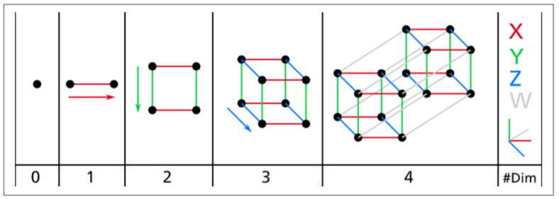
Increasing dimension

Slide 5
Increasing dimension => Curse of dimensionality
Dim | Points | Distance
1 | 1,5 | 4
2 | (1,1), (5,5) | 5.66
3 | (1,1,1), (5,5,5) | 6.93
4 | (1,1,1,1), (5,5,5,5) | 8
5 | (1,1,1,1,1), (5,5,5,5,5) | 8.94

Slide 6
Issues with high dimensionality
Overfitting models
Not enough training set

Slide 7
Approaches to dimensionality reduction
Projection
Manifold Learning

Slide 8
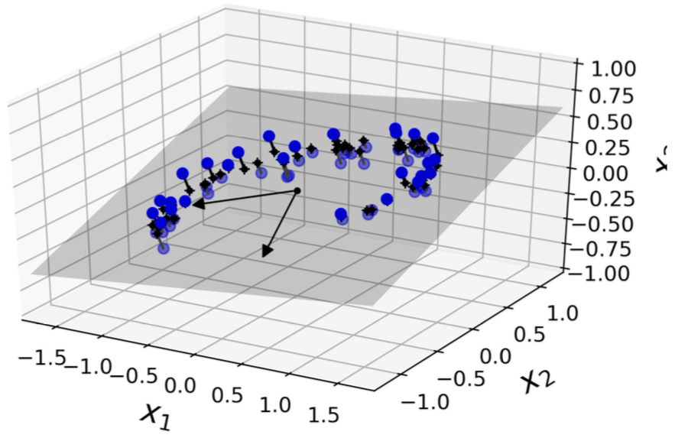
Projection

Slide 9
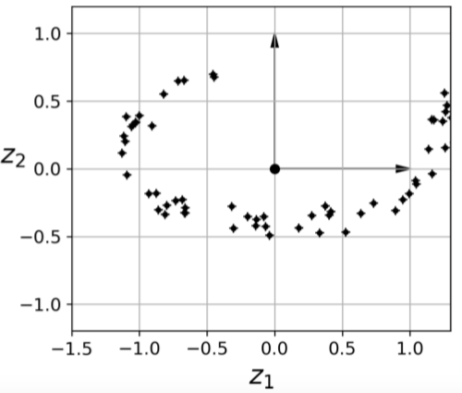
Projection
Results in info loss

Slide 10

Issue with projection: Eg swiss roll

Slide 11
Issue with projection: Eg swiss roll

Slide 12
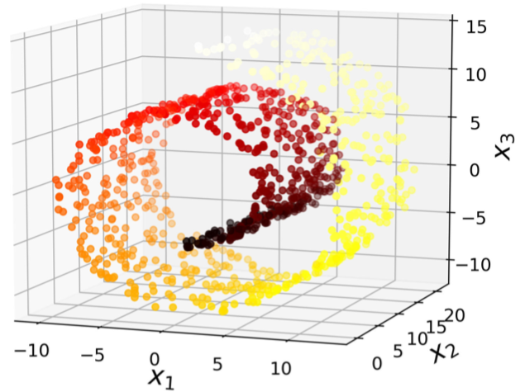
Swiss roll data set

Slide 13
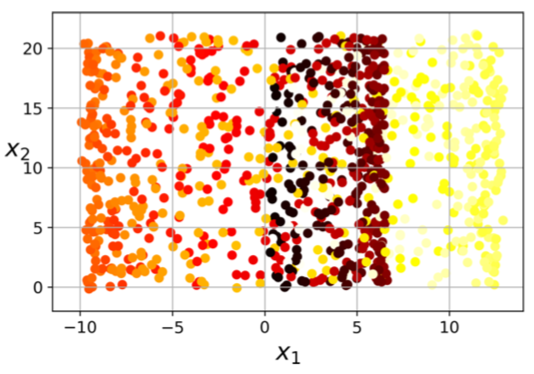
Projection of swiss roll data sets

Slide 14
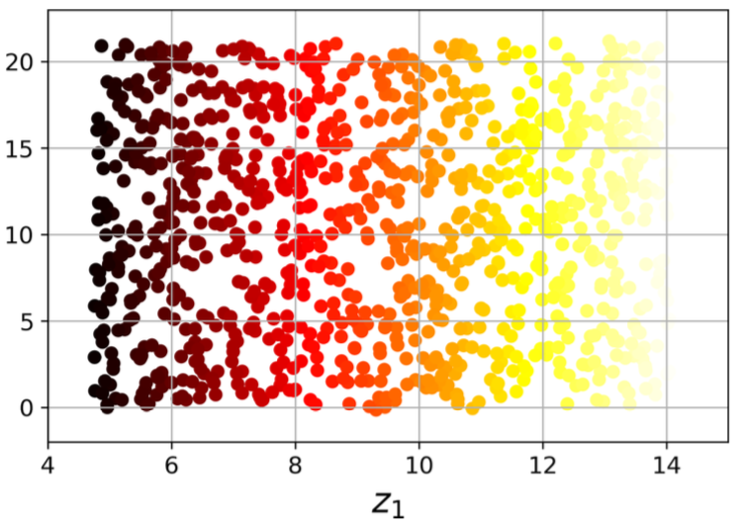
Manifold Learning: Unrolling

Slide 15
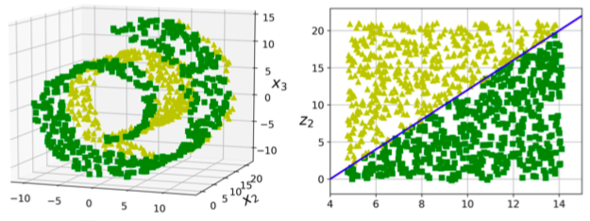
Manifold Learning
2 d manifold is a 2D shape which can be be bent and twisted in a higher dimensional shape, say 3.
Task at hand will be simpler in most cases if it is expressed in lower dimensional manifold.

Slide 16
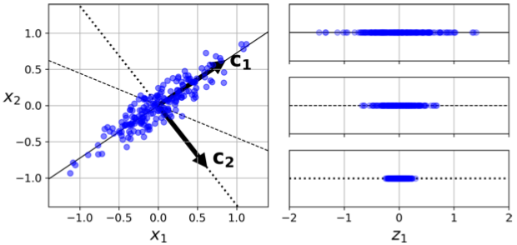
Principal Component Analysis - PCA
Identifies the right hyperplane that is closest to the data, then projects into it.
Right…?

Slide 17
Principal Component Analysis - PCA
Choose the hyperplane which preserves the maximum amount of variance.
Principal component: the axis which has this property.
For, 3D or higher, choose another axis, which is orthogonal(perpendicular) to the PC, which preserves maximum variance.

Slide 19
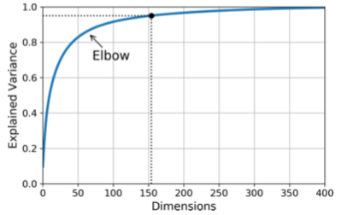
Characteristics of PCA
Explained variance ratio: Proportion of data’s variance explained by each PC
# of PC: Min of PCS required to keep around 95% of variance. Usually 2 or 3.

Slide 20
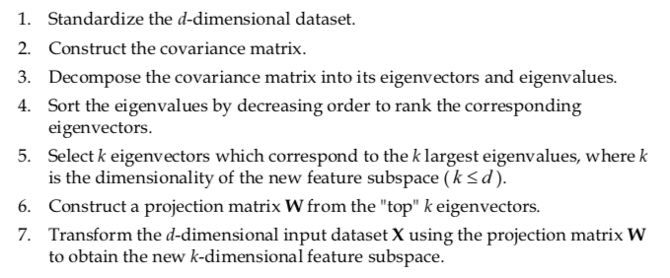
Implementation of PCA

Slide 21
Implementation of PCA

